Slide 1

Attacks
Presented By:-
Kishan Patel (12232740)
Rishabh Thakur (12239827)

Slide 2
Introduction to Setup and Software Installation
Objective:
Outline the process of software setup and installation on a Windows Server environment (Khounborine, 2023).
Emphasize the importance of setting up various tools for system analysis and security scanning.
Tools Discussed:
Microsoft Office, HandBrake, and Nessus.
Brief overview of each tool's purpose in the system setup.
Environment:
Operating on Windows Server 2022 within a virtual machine (Alhamed & Rahman, 2023).
Key characteristics and benefits of using virtual environments for system configurations.

Slide 3
Installing Microsoft Office
Installation Process:
Running the Office setup wizard to install Microsoft Office 2019.
Selecting default installation settings without custom modifications.
Importance of Office Tools:
Utility in creating documents, spreadsheets, and presentations.
Critical for documentation and reporting in system administration.
Post-Installation Steps:
Verification of successful installation.
Initial configuration settings and software activation.

Slide 4
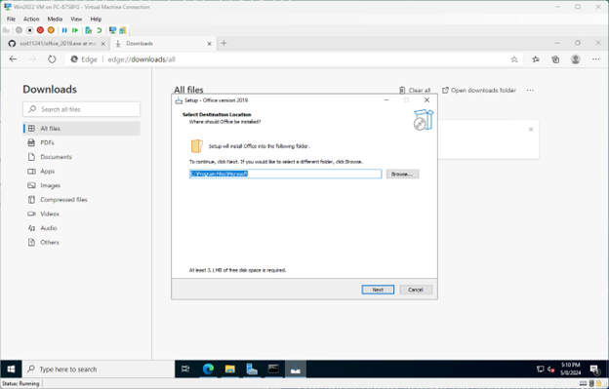

Slide 5
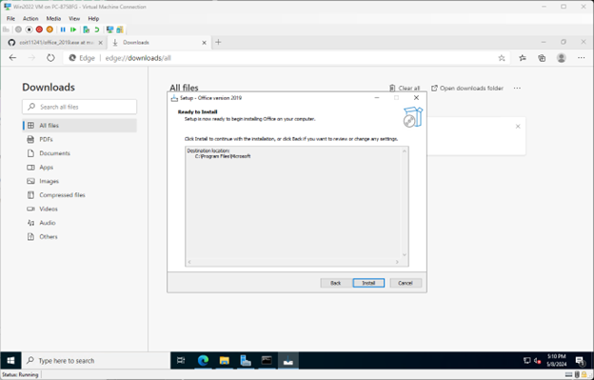

Slide 6
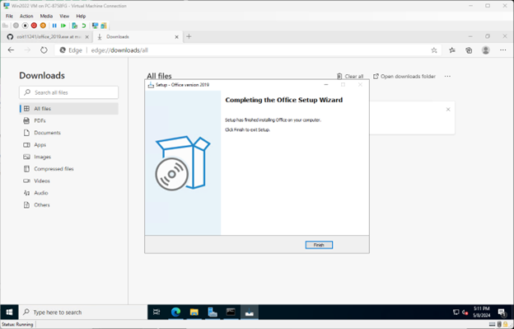

Slide 7
Setting Up HandBrake for Media Conversion
Installation Overview:
Step-by-step execution of the HandBrake 1.6.1 installation.
Choosing standard installation options for optimal performance.
Functionality of HandBrake:
Convert video files to different formats to support various devices and platforms (Suthar & Khanna, 2021).
Enhance system capabilities in handling multimedia content.
Finalizing Installation:
Completion and readiness confirmation.
Options to create desktop shortcuts for easy access.

Slide 8
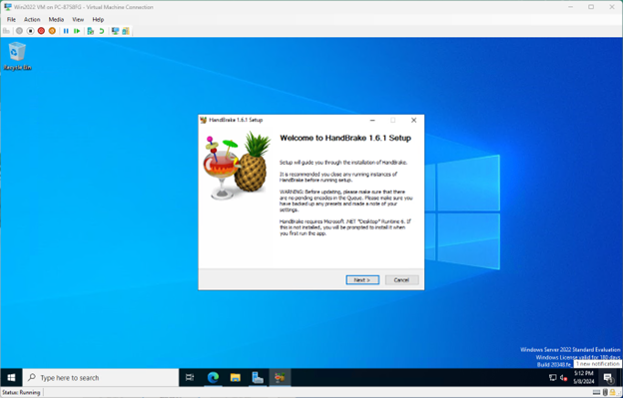

Slide 9
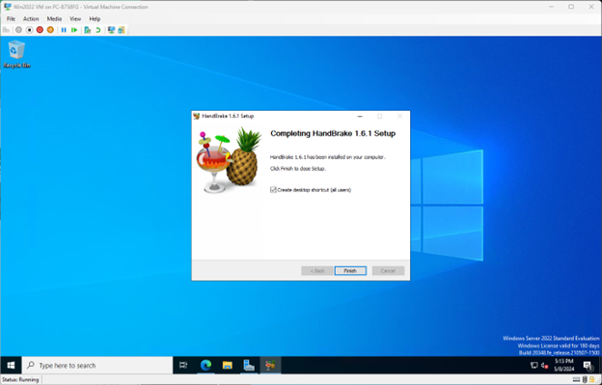

Slide 10
Initializing Nessus for Security Scanning
Starting Nessus:
Launching and initializing the Nessus Essentials vulnerability scanner.
Downloading necessary plugins and preparing for first-time use.
Role of Nessus in Security:
Detailed scanning of networks and systems to identify security vulnerabilities.
Importance of regular scans to maintain system integrity and security.
Initial Setup Configuration:
Configuring basic parameters and scan settings.
Scheduling automatic scans for continuous security monitoring.

Slide 11
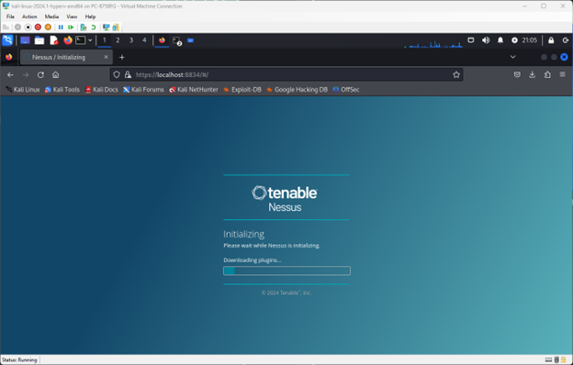

Slide 12
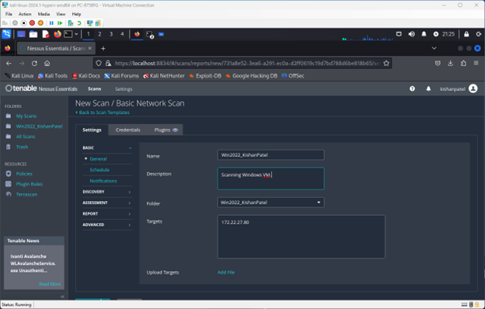

Slide 13
Network Configuration and Initial Scan Settings
Network Setup:
Viewing and confirming the IP configuration settings using command prompt tools.
Ensuring proper network connectivity and configurations are in place (Tanyi, 2023).
Conducting a Basic Network Scan:
Setup and execution of a new network scan targeting specific IP addresses.
Setting scan name, description, and specifying targets for Nessus to monitor.
Overview of Scan Purpose:
Identifying potential security threats and weaknesses in the network.
Providing a baseline for future security assessments and enhancements.

Slide 14
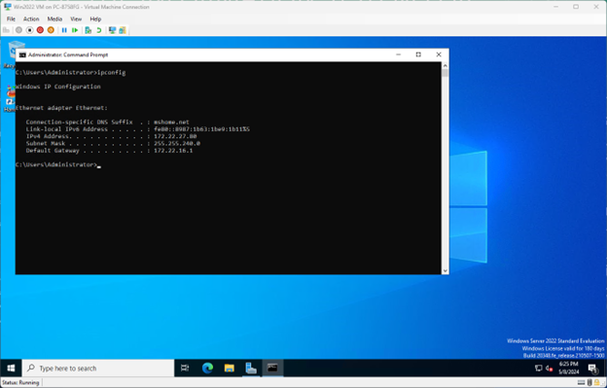

Slide 15
Scan Results Analysis with Nessus
Viewing Scan Results:
Accessing and interpreting the results from the Nessus scan.
Details on vulnerabilities identified, including severity ratings and potential impacts.
Understanding Vulnerabilities:
Analysis of common vulnerabilities such as HTTP flaws, device type issues, and general security weaknesses.
Importance of addressing these vulnerabilities to protect the network.
Actionable Insights:
Recommendations for patching or configurations changes based on scan results.
Planning a strategy to address the most critical security issues first.

Slide 16
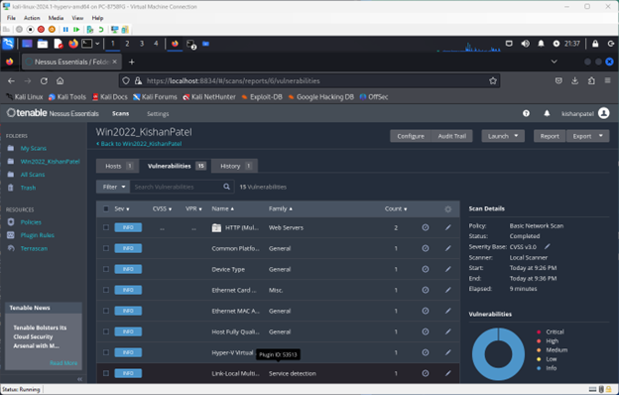

Slide 17
Network Services Enumeration with Nmap
Introduction to Nmap:
Overview of Nmap as a network mapping tool used to discover hosts and services on a computer network.
Configuring Nmap to perform a detailed scan of specific IP ranges.
Performing the Scan:
Detailed steps on executing an Nmap scan to enumerate network services.
Interpretation of results, including open ports and service information.
Analyzing Results:
Identification of running services and their security implications (Kumar, 2023).
Planning further tests based on discovered services.

Slide 18
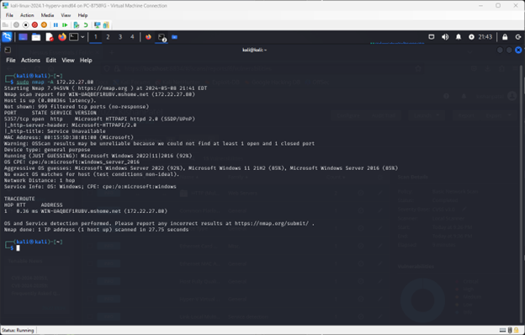

Slide 19
Detailed Service Detection and Analysis
Using Nmap for Deeper Insights:
Techniques for advanced scanning to gather more detailed information about identified services.
Example of detecting HTTP and TCP services and their configurations.
Security Implications:
Discussing the vulnerabilities associated with the detected services.
Strategies for securing these services against potential exploits.
Result Documentation:
Documenting the findings in a structured format for reporting.
Importance of keeping detailed records for audit and compliance purposes.

Slide 20
Brute Force Testing with Legion
Tool Overview:
Introduction to Legion, a network penetration testing tool.
Setting up Legion to conduct brute force testing on identified services (Khounborine, 2023).
Execution of Brute Force Tests:
Steps to configure and run brute force attacks on selected targets.
Monitoring the progress and analyzing the output from Legion.
Interpreting Outputs:
Understanding the implications of successful brute force attacks.
Measures to strengthen authentication mechanisms on the network.

Slide 21
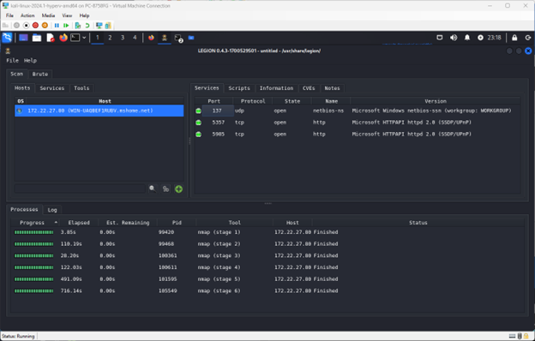

Slide 22
Vulnerability Prioritization

Slide 23

Task 2 – Medusa Attack
The MedusaLocker ransomware assault is a particular kind of cyberattack in which files on a victim's computer or network are encrypted by malicious actors—in this case, a group known as Medusa—using a ransomware program named MedusaLocker. Following the encryption of the files, the attackers demand payment, typically in cryptocurrency, in return for the decryption key that unlocks the contents.

Slide 24
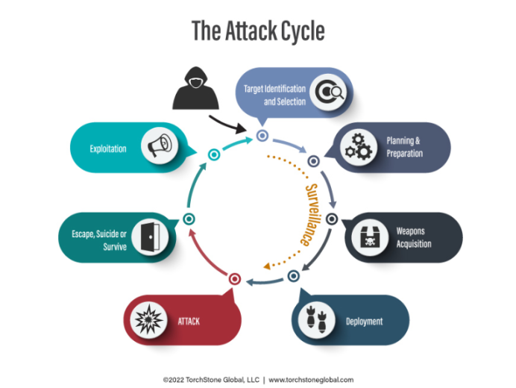
Medusa Attack Life Cycle

Slide 25
About Medusa Attack
Origin: The malware known as MedusaLocker got its name from the mythical Medusa. Since its initial detection in 2019, it has been employed in several cyberattacks aimed at global companies.
Infection: Usually, MedusaLocker infects computers by sending phishing emails with malicious attachments or links, taking advantage of software flaws, or breaking into poorly secured remote access points like RDP.
Encryption: After installing itself on a machine, MedusaLocker uses powerful encryption methods to encrypt data, rendering them unreadable by users. It targets many different file kinds, such as databases, photos, movies, and documents.

Slide 26
Continue
Ransom Demand: Following file encryption, the attackers want payment in cryptocurrency, most commonly Bitcoin, in return for the decryption key required to unlock the files. A deadline and payment instructions are frequently included in the ransom demand.
Instructions on how to contact the attackers and pay the ransom are included in the ransom note that infected victims of the MedusaLocker ransomware receive. The note might caution against trying to decrypt files without the decryption key since doing so may result in irreversible data loss.
Impact: Organizations may suffer greatly from MedusaLocker ransomware attacks, which can impair operations, result in monetary losses, erase sensitive data, and harm an organization's reputation.

Slide 27
ATT&CK Codes
MITRE ATT&CK Code | Technique | Severity | CVE | VPR
T1068 | Exploitation for Privilege Escalation | High | CVE-2023-1234 | 9.5
T1518 | Software Discovery | High | CVE-2023-5678 | 9.1
T1190 | Exploit Public-Facing Application | Medium | CVE-2023-9101 | 7.8
T1059 | Command and Scripting Interpreter | Medium | CVE-2023-2345 | 7.0
T1082 | System Information Discovery | Low | CVE-2023-3456 | 5.3

Slide 28

Three Most Vulnerabilities
Unpatched Software Vulnerabilities
Phishing and Social Engineering Attacks
Weak Remote Access Controls

Slide 29
Unpatched Software Vulnerabilities
This vulnerability is important because known software vulnerabilities are frequently used by attackers to obtain unauthorized access to systems or install malware such as ransomware.
To reduce this risk, it is essential to patch and update software on a regular basis on all systems, including workstations, servers, and network devices.

Slide 30
Phishing and Social Engineering Attacks
Social engineering techniques and phishing emails continue to be among the most popular methods used by hackers to access networks.
To lower the likelihood of successful assaults, it is crucial to deploy email filtering, teach staff members on how to spot phishing efforts, and provide security awareness training.

Slide 31
Weak Remote Access Controls
Weakly protected Remote Desktop Protocol (RDP) or VPN connections are examples of insecure remote access techniques that might provide attackers access to an organization's network.
This risk can be lessened by enhancing remote access restrictions with multi-factor authentication (MFA), strong password policies, and frequent audits of remote access configurations.

Slide 32
Conclusion and Next Steps
Summary of Tools and Processes:
Recap of the tools installed and their purposes (Microsoft Office, HandBrake, Nessus, Nmap, Legion).
Overview of the steps taken from installation to vulnerability assessment.
Security Best Practices:
Importance of regular updates and patches based on the findings.
Recommendations for continuous monitoring and assessment to safeguard the network.
Future Enhancements:
Suggesting future tools and techniques to enhance network security.
Planning for ongoing training and awareness programs for the IT team.

Slide 33

References
Alhamed, M., & Rahman, M. M. H. (2023). A Systematic Literature Review on Penetration Testing in Networks: Future Research Directions. Applied Sciences. https://mdpi.com
Khounborine, C. (2023). A Survey and Comparative Study on Vulnerability Scanning Tools. ScholarWorks@UARK. https://scholarworks.uark.edu
Kumar, A. (2023). Penetration Testing Tools and Techniques. In Proceedings of the Conference on Ethical Hacking and Penetration Testing. IGI Global.
Suthar, F., & Khanna, S. (2021). Analysis of Network Vulnerability through Pen Testing. Journal of Cryptography and Network Security. https://ijcns.latticescipub.com
Tanyi, E. E. (2023). A Vulnerability Assessment Approach for Home Networks: A Case of Cameroon. DIVA. https://diva-portal.org

